Slide 1


AI BASED CROP DISEASE DETECTION CSA1711-Artificial Intelligence
Under the supervision of:
Dr.Krishnakumar K
Submitted By:
G.Bhavya(192411114)
S.Mythili(192411250)
S.Roobini(192421114)

Slide 2
INTRODUCTION
Agriculture plays a vital role in food production and the economy, but crop diseases significantly affect crop yield and quality.
Early detection of crop diseases is essential to prevent the spread of infections and minimize losses for farmers.
Traditional disease detection methods rely on manual inspection, which is time-consuming, expensive, and may not always be accurate.
Artificial Intelligence (AI) and Deep Learning can automatically analyze leaf images to identify crop diseases quickly and accurately.
The AI-Based Crop Disease Detection System helps farmers make timely decisions, improve productivity, reduce pesticide misuse, and support sustainable farming practices.

Slide 3
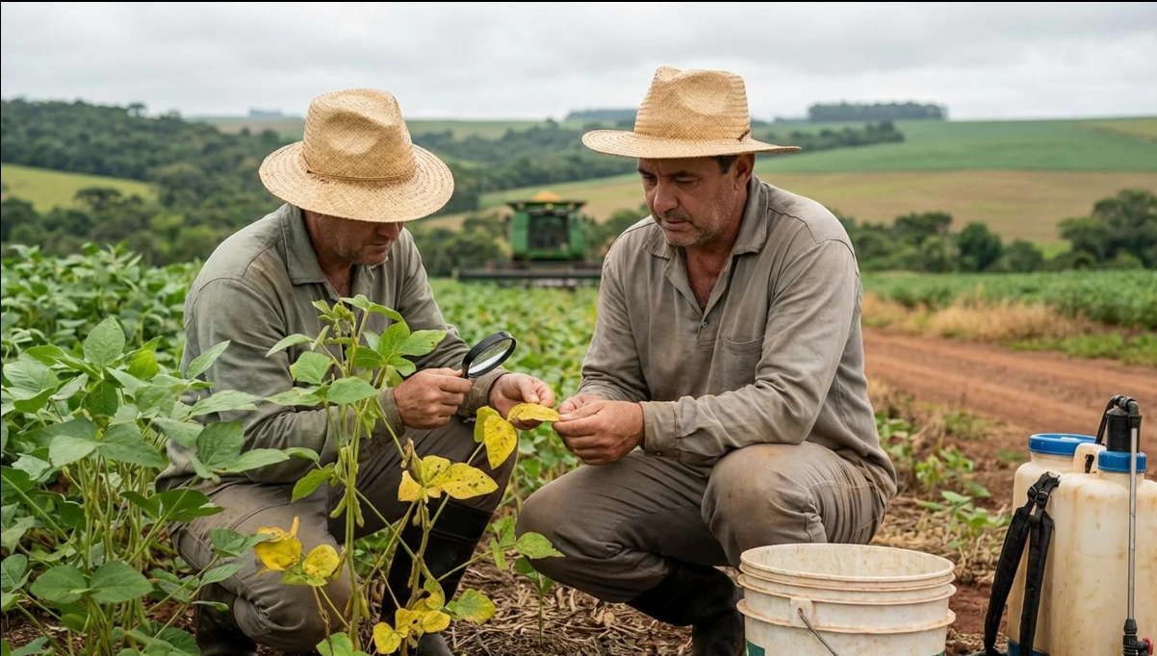
PROBLEM STATEMENT
Farmers may find it difficult to identify diseases accurately
Traditional detection is time-consuming
Lack of agricultural experts in rural areas
Diseases can spread rapidly before detection
Incorrect identification can lead to improper pesticide usage

Slide 4
OBJECTIVES:
Detect Crop Diseases – Use AI to identify diseases from crop leaf images.
Classify Diseases – Find out the specific type of disease affecting the crop.
Early Detection – Detect diseases at an early stage to prevent them from spreading.
Reduce Crop Loss – Help farmers take timely action and reduce damage to crops.
Provide Recommendations – Give basic information about the disease and suggest suitable preventive measures.
Improve Crop Production – Support farmers in maintaining healthy crops and improving agricultural productivity.

Slide 5
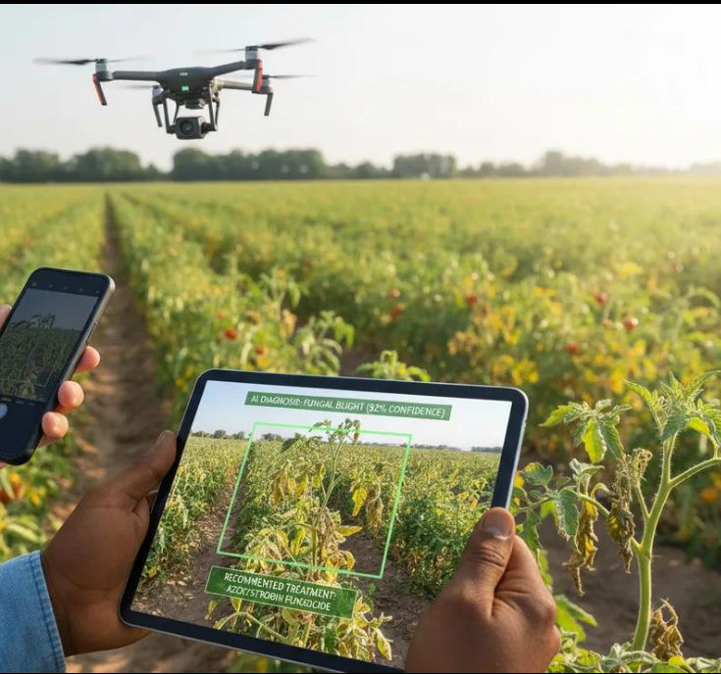
PROPOSED SYSTEM
User captures/uploads an image of the crop leaf
Image is preprocessed
AI model analyzes the image
Disease is identified and classified
System displays disease name and recommended action

Slide 6
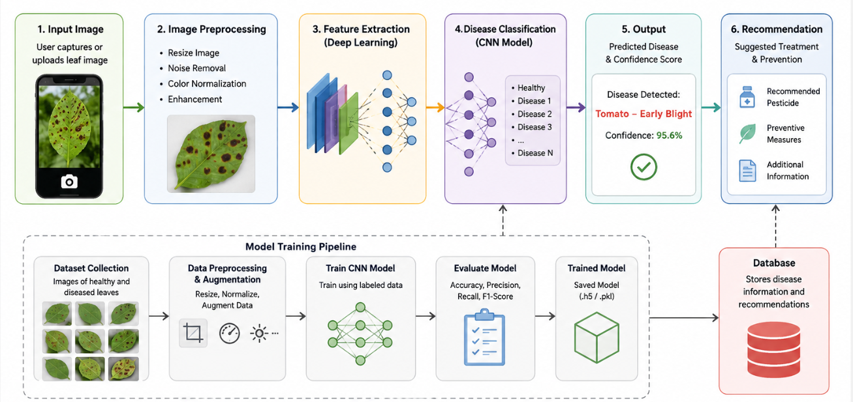
SYSTEM ARCHITECTURE

Slide 7
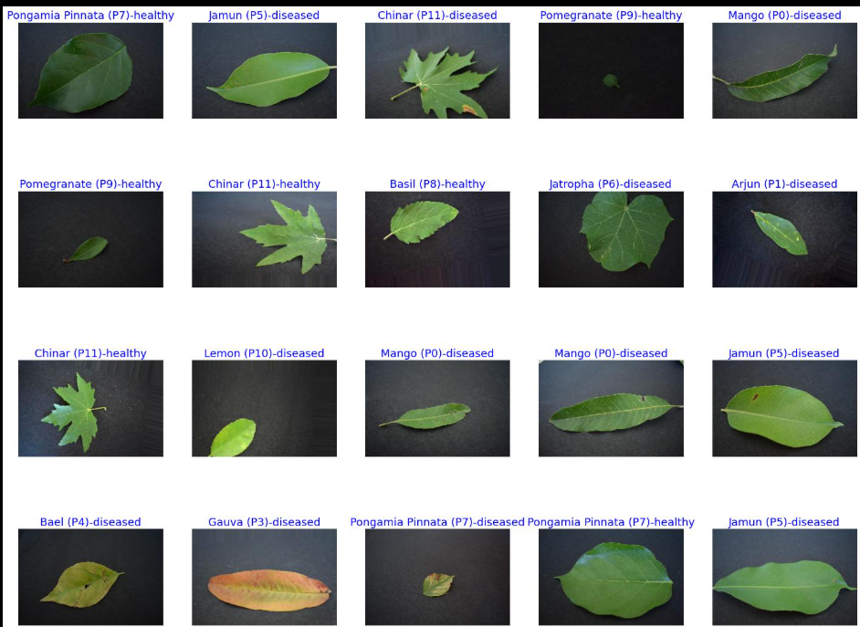
MODULE - 1
IMAGE DATASET PREPARATION
Collect Images – Gather healthy and diseased crop leaf images.
Clean the Dataset – Remove unclear, duplicate, or damaged images.
Resize Images – Convert all images to the same size (e.g., 224 × 224 pixels).
Label and Organize – Group images into folders based on disease type.
Split the Dataset – Divide the dataset into Training, Validation, and Testing sets for model development.

Slide 8
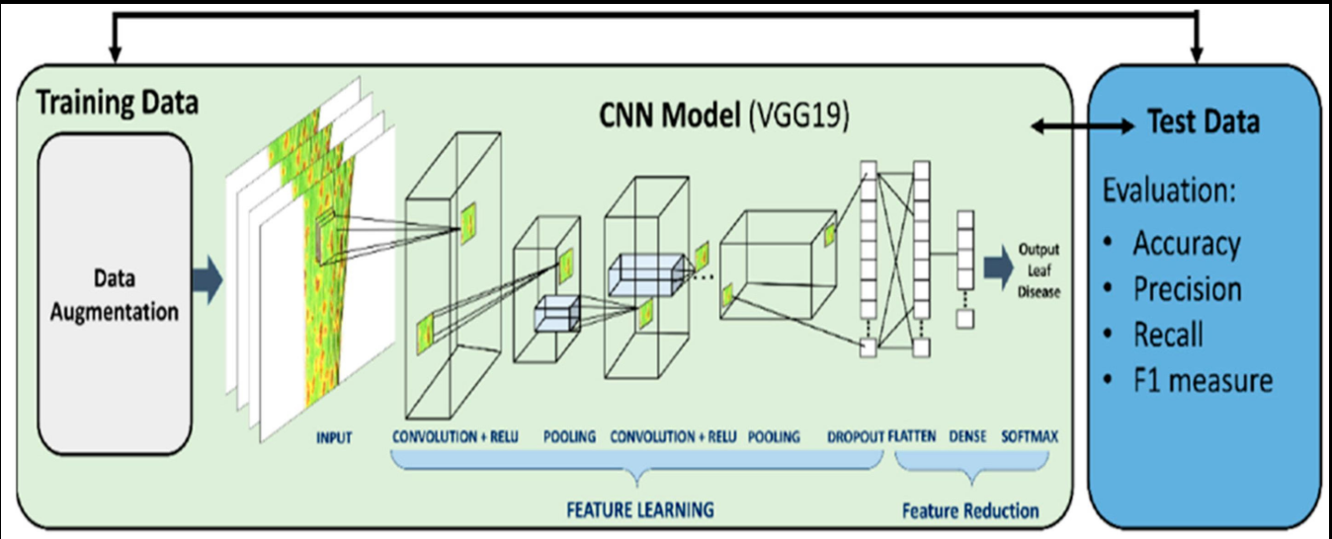
MODULE-2
CNN Model Training
Load the Dataset – Import the training and validation images.
Build the CNN Model – Create the CNN architecture with different layers.
Train the Model – Feed the training images to the CNN to learn patterns.
Validate the Model – Check the model's performance using validation data.
Save the Model – Store the trained model for future disease prediction.

Slide 9
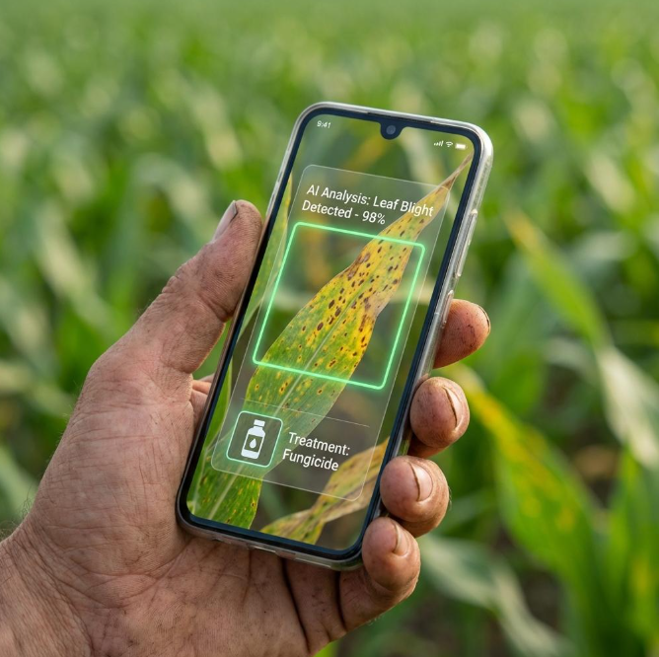
MODULE-3
Disease Prediction App
Upload Image – The user uploads a crop leaf image.
Process the Image – The app prepares the image for prediction.
Predict Disease – The trained CNN model identifies the disease.
Display Result – The app shows the predicted disease name.
Provide Recommendation – The app suggests suitable treatment or preventive measures.

Slide 10
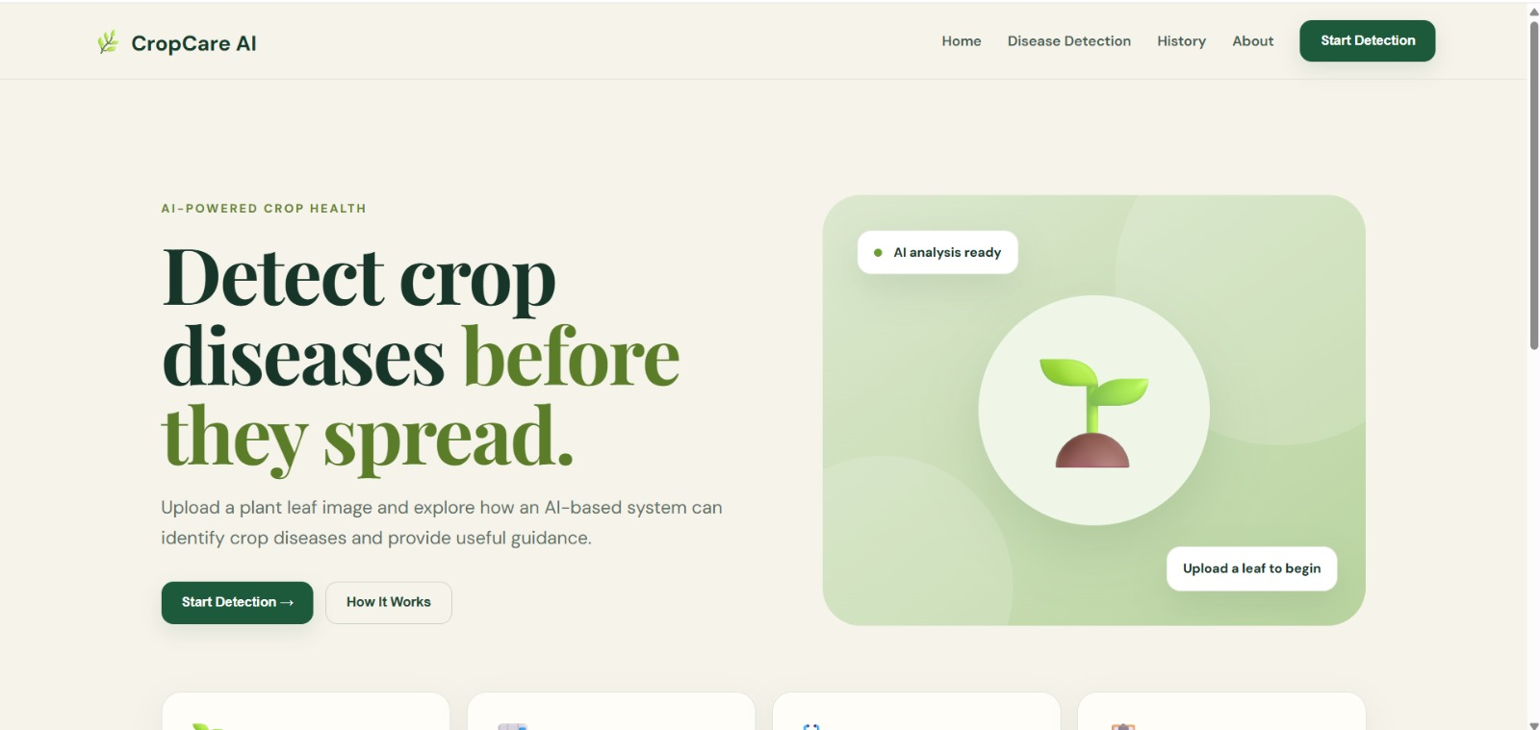
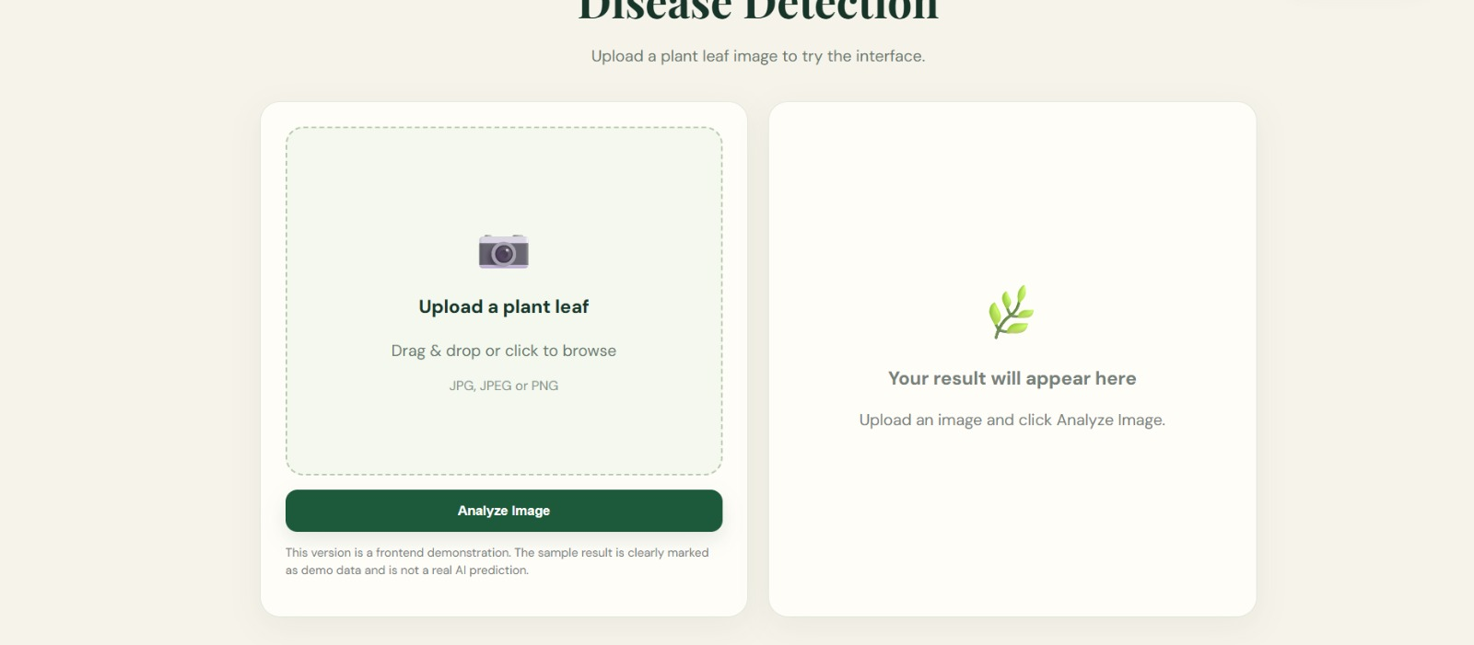
Implementation output

Slide 11
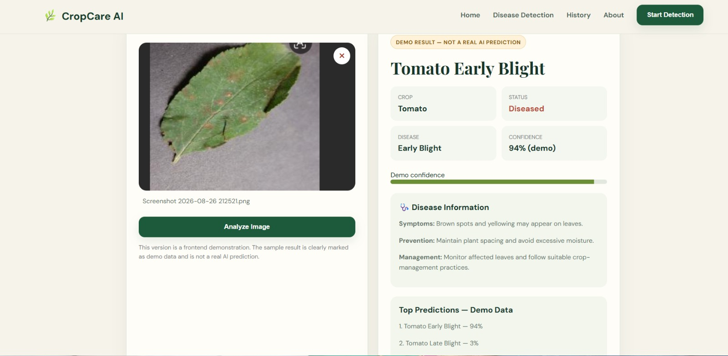
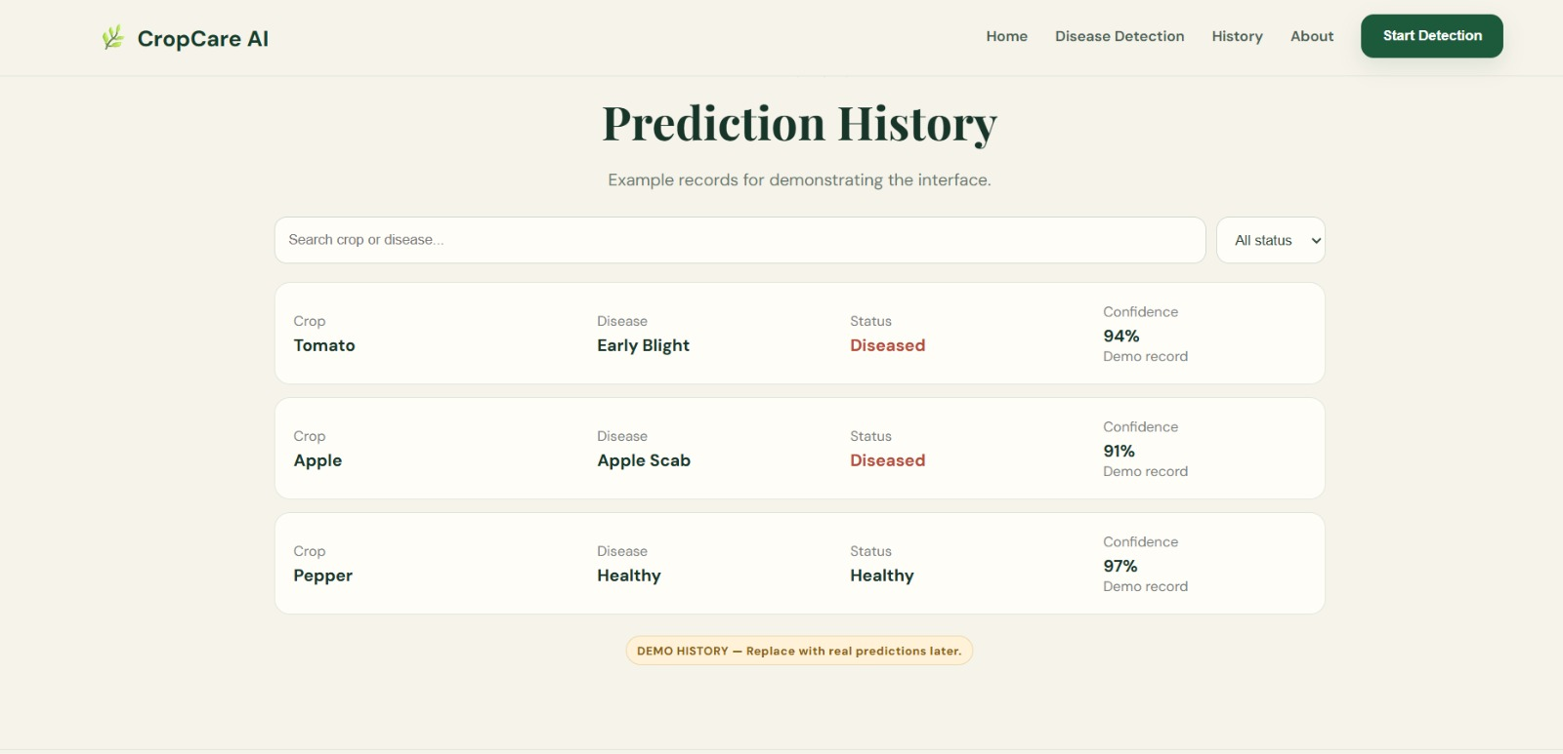
Implementation output

Slide 12
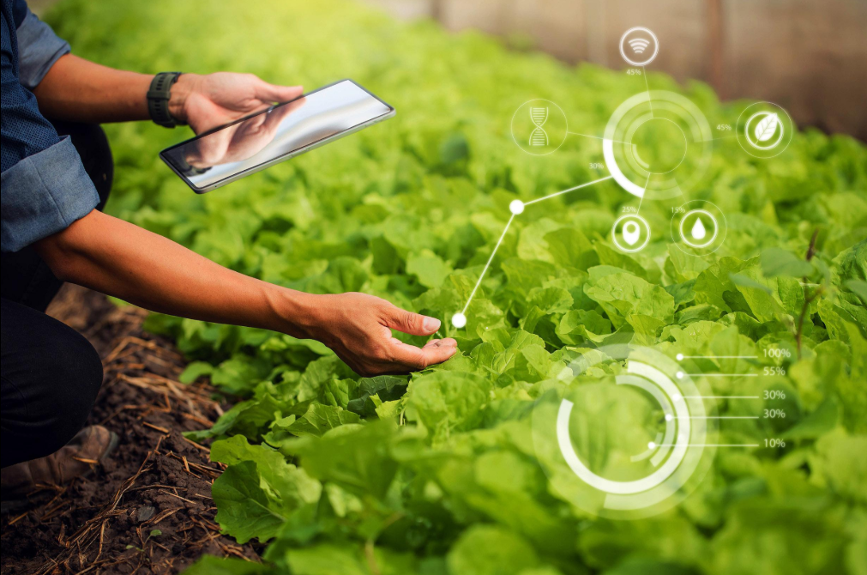
FUTURE ENHANCEMENTS
Mobile application
Real-time camera detection
Support for more crops and diseases
Multilingual support for farmers
Weather-based disease prediction
IoT-based smart farming integration
Voice-based assistance

Slide 13
CONCLUSION
The AI-Based Crop Disease Detection System is an effective solution for identifying plant diseases quickly and accurately using Artificial Intelligence and Deep Learning. By analyzing images of crop leaves, the system enables early disease detection, helping farmers take timely corrective measures to reduce crop losses and improve productivity. It also minimizes the need for manual inspection, saves time, and supports efficient use of pesticides. Overall, this project contributes to smarter and more sustainable agricultural practices, improving crop health, increasing yield, and supporting food security.

Slide 14
THANK YOU…

